Slide 1
Relations: The Second Time Around
Chapter 7
Equivalence Classes

Slide 2
7.1 Relations Revisited: Properties of Relations
Ex. 7.3 Consider a finite state machine M=(S,I,O,v,w).
(a) For s₁,s₂ in S, define s₁Rs₂ if v(s₁,x)=s₂ for some x in I.
Relation R establishes the first level of reachability.
(b) The second level of reachability. s₁Rs₂ if v(s₁,x₁x₂)=s₂
for some x₁x₂ in I². For the general reachability relation we
have v(s₁,y)=s₂ for some y in I*.
(c) Given s₁,s₂ in S, the relation 1-equivalence, which is denoted
by s₁E₁s₂, is defined when w(s₁,x)=w(s₂,x) for all x in I. This
idea can be extended to states being k-equivalence, where
s₁E_{k}s₂ if w(s₁,y)=w(s₂,y) for all y in I^{k}.
If two states are k-equivalent for all k in Z⁺, then they are called
equivalent.

Slide 3
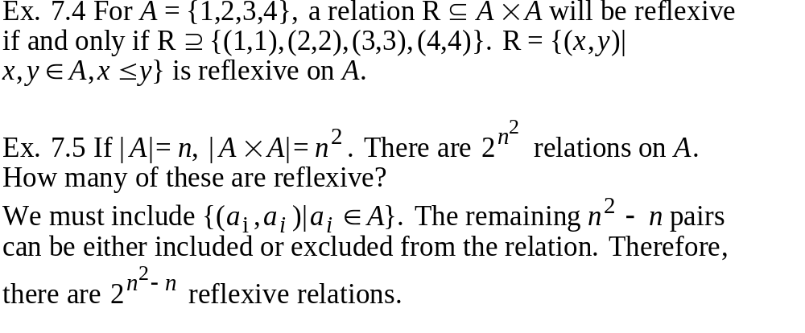
7.1 Relations Revisited: Properties of Relations
Def. 7.2 A relation R on a set A is called reflexive if for all
x in A, (x,x) is in R.

Slide 4
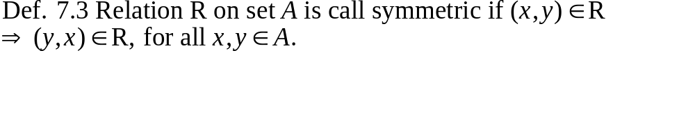
7.1 Relations Revisited: Properties of Relations
Ex. 7.6 With A={1,2,3}, we have:
(a) R₁={(1,2),(2,1),(1,3),(3,1)}, symmetric, but not reflexive;
(b) R₂={(1,1),(2,2),(3,3),(2,3)}, reflexive, but not symmetric;
(c) R₃={(1,1),(2,2),(3,3)}, R₄={(1,1),(2,2),(3,3),(2,3),(3,2)},
both reflexive and symmetric;
(d) R₅={(1,1),(2,3),(3,3)}, neither reflexive nor symmetric.

Slide 5
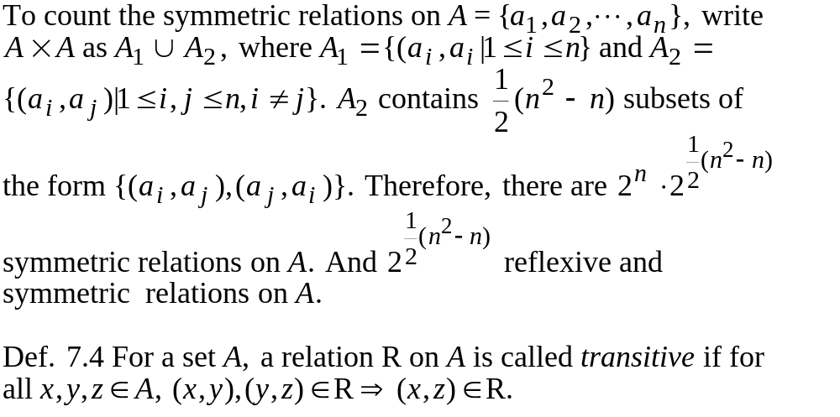
7.1 Relations Revisited: Properties of Relations

Slide 6
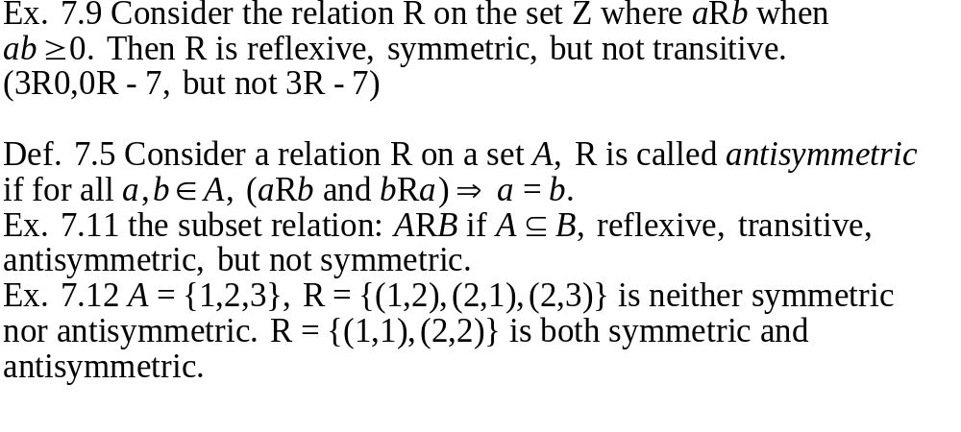
7.1 Relations Revisited: Properties of Relations
Ex. 7.8 Define the relation R on the set Z⁺ by aRb if a exactly
divides b. Then R is transitive, reflexive, but not symmetric (2R6,
but not 6R2)

Slide 7
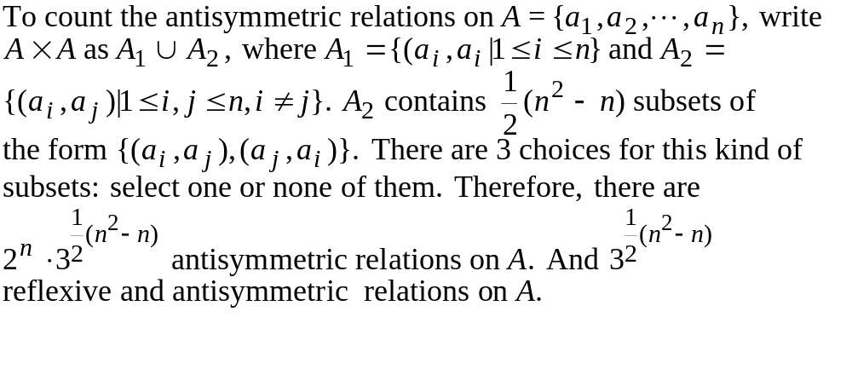
7.1 Relations Revisited: Properties of Relations

Slide 8
7.1 Relations Revisited: Properties of Relations
Def. 7.6 A relation R os a set A is called a partial order, or a
partial ordering relation, if R is reflexive, antisymmetric, and
transitive. (It is called a total order if for any a,b in A, either a Rb
or bRa).
Ex. 7.15. Define the relation R on the set Z⁺ by aRb if a exactly
divides b. R is a partial order.
Def. 7.7 An equivalence relation R on a set A is a relation that is
reflexive, symmetric, and transitive.
Examples: aRb if a mod n=b mod n
The equality relation {(a_{i},a_{i})|a_{i} in A} is both a partial order and
an equivalence relation.

Slide 9
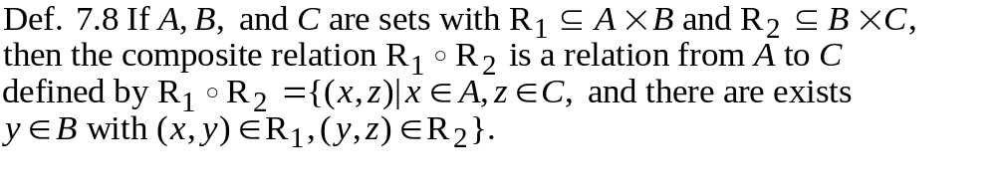
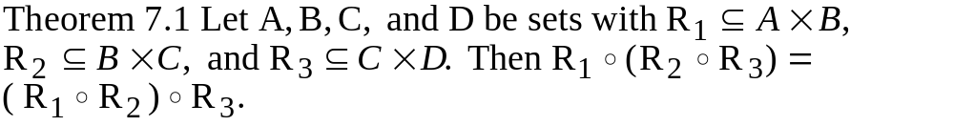
7.2 Computer Recognition: Zero-One Matrices and Directed Graphs
(Note the different ordering with function composition.)
Ex. 7.17 A={1,2,3,4}, B={w,x,y,z}, and C={5,6,7}. Consider
R₁={(1,x),(2,x),(3,y),(3,z)}, a relation from A to B, and R₂=
{(w,5),(x,6)}, a relation from B to C. Then R₁ R₂={(1,6),(2,6)}
is a relation from A to C.

Slide 10
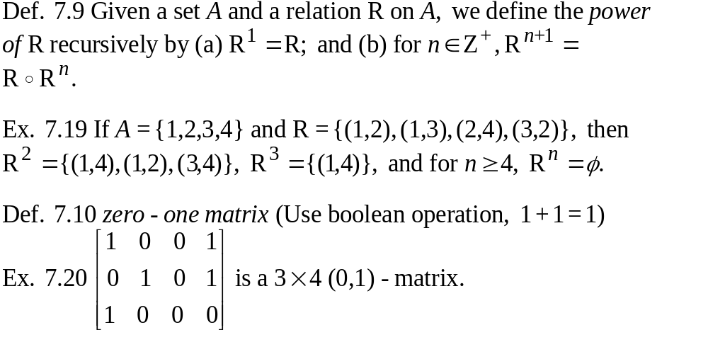
7.2 Computer Recognition: Zero-One Matrices and Directed Graphs

Slide 11
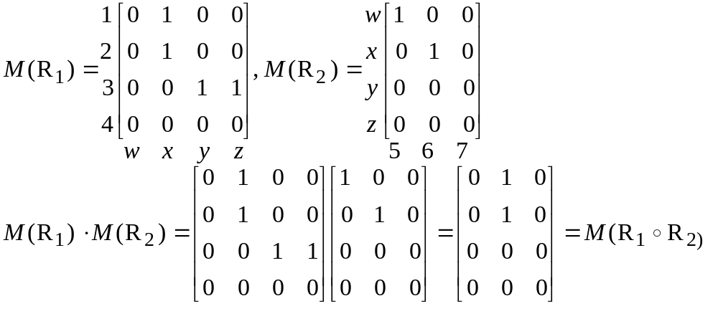
7.2 Computer Recognition: Zero-One Matrices and Directed Graphs
Ex. 7.21 A={1,2,3,4}, B={w,x,y,z}, and C={5,6,7}.
R₁={(1,x),(2,x),(3,y),(3,z)}, a relation from A to B, and R₂=
{(w,5),(x,6)}, a relation from B to C.
relation matrix

Slide 12

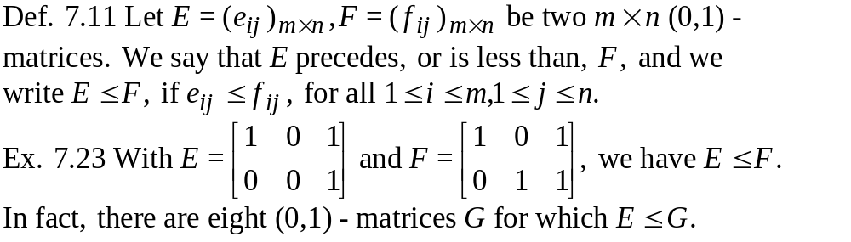
7.2 Computer Recognition: Zero-One Matrices and Directed Graphs
Let A be a set with |A|=n and R a relation on A. If M(R) is the
relation matrix for R, then
(a) M(R)=0 (the matrix of all 0's) if and only if R is empty
(b) M(R)=1 (the matrix of all 1's) if and only if R=A A
(c) M(R^{m})=[M(R)}^{m}, for m in Z⁺.

Slide 13
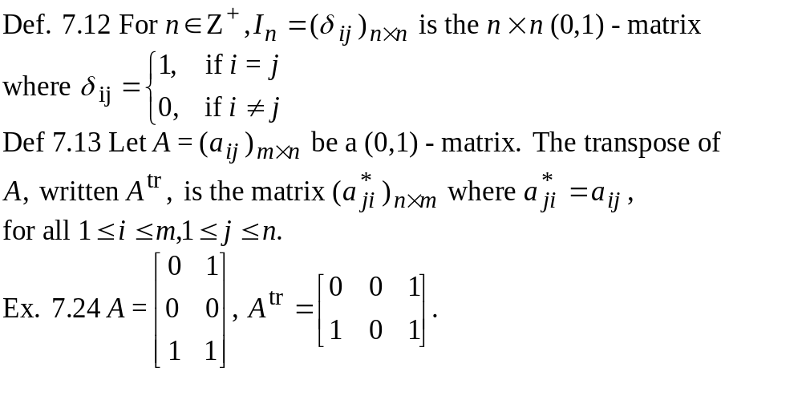
7.2 Computer Recognition: Zero-One Matrices and Directed Graphs

Slide 14
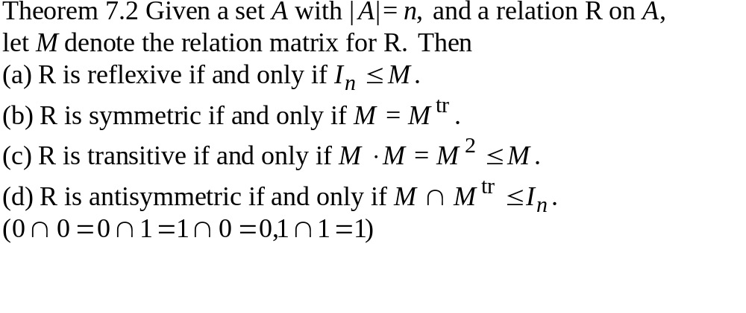
7.2 Computer Recognition: Zero-One Matrices and Directed Graphs

Slide 15
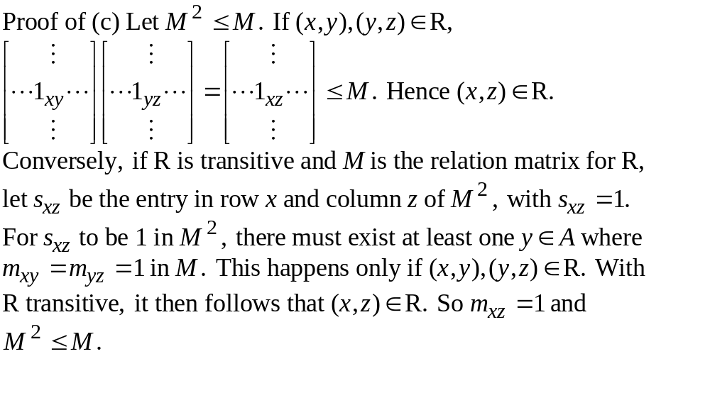
7.2 Computer Recognition: Zero-One Matrices and Directed Graphs

Slide 16
7.2 Computer Recognition: Zero-One Matrices and Directed Graphs
Def. 7.14 Directed Graphs G=(V,E) (Digraph)
Ex. 7.25
a loop
V={1,2,3,4,5}
E={(1,1),(1,2),(1,4),(3,2)}
1
2
4
3
5
1 is adjacent to 2.
2 is adjacent from 1.
isolated vertex (node)
Undirected graphs: no direction in edges

Slide 17
7.2 Computer Recognition: Zero-One Matrices and Directed Graphs
Ex. 7.26
Construct a directed graph G=(V,E), where
V={s₁, s₂, s₃, s₄, s₅, s₆, s₇, s₈} and (s_{i}, s_{j}) in E
if s_{i} must be executed before s_{j}.
(s₁) b:=3;
(s₂) c:=b+2;
(s₃) a:=1;
s₅
s₇
(s₄) d:=a*b+5;
precedence graph
(s₅) e:=d-1;
(s₆) f:=7;
s₄
s₂
s₈
(s₇) e:=c+d;
(s₈) g:=b*f;
s₃
s₁
s₆
precedence constraint scheduling
In general, n tasks,
m processors: NP-complete
m=2: polynomial
m=3: open problem
3 processors: 3 time units
2 processors: 4 time units

Slide 18
7.2 Computer Recognition: Zero-One Matrices and Directed Graphs
Ex. 7.27 relations and digraphs
A={1,2,3,4}, R={(1,1),(1,2),(2,3),(3,2),(3,3),(3,4),(4,2)}
2
2
a connected graph: a path
exists between any two
vertices
1
1
3
3
4
4
path: no repeated vertex
directed graph
representation
associated
undirected graph
cycle: a closed path (the
starting and ending vertices
are the same)
Def. 7.15 Strongly connected digraph
a directed path exists between any two vertices
The above graph is not strongly connected. (no directed path from 3 to 1)

Slide 19
7.2 Computer Recognition: Zero-One Matrices and Directed Graphs
Ex. 7.28 Components
1
2
1
2
3
4
3
4
two components
one component
Ex. 7.29 Complete Graphs: K_{n}
(n vertices with n(n-1)/2 edges)
K₅
K₁
K₂
K₃
K₄

Slide 20
7.2 Computer Recognition: Zero-One Matrices and Directed Graphs
directed graphs relations
adjacency matrices relation matrices
Ex. 7.30 If R is a relation on finite set A, then R is reflexive if
and only if its directed graph contains a loop at each vertex.
Ex. 7.31 A relation R on a finite set A is symmetric if and only
if its directed graph contains only loops and undirected edges.
Ex. 7.31 A relation R on a finite set A is transitive if and only if in
its directed graph if there is a path from x to y, (x,y) is an edge.
A relation R on a finite set A is antisymmetric if and only if in
its directed graph there are no undirected edges aside from loops.

Slide 21
7.2 Computer Recognition: Zero-One Matrices and Directed Graphs
Ex. 7.33 A relation on a finite set A is an equivalence relation
if and only if its associated (undirected) graph is one complete
graph augmented by loops at every vertex or consists of the
disjoint union of complete graphs augmented by loops at every
vertex.
reflexive: loop on each vertex
symmetric: undirected edge
transitive: disjoint union of complete graphs

Slide 22
7.3 Partial Orders: Hasse Diagrams
natural counting: N
x+5=2 : Z
2x+3=4 : Q
x²-2=0 : R
x²+1=0 : C
Something was lost when we went
from R to C. We have lost the ability
to "order" the elements in C.
Let A be a set with R a relation on A. The pair (A,R) is called
a partially ordered set, or poset, if relation R is a partial order.
Ex. 7.34 Let A be the courses offered at a college. Define R on A
by xRy if x,y are the same course (reflexive) or if x is a prerequisite
for y. Then R makes A into a poset.

Slide 23
7.3 Partial Orders: Hasse Diagrams
Ex. 7.36 PERT (Performance Evaluation and Review Technique)
A poset
J₄
J₃
J₁
J₆
J₇
J₂
J₅
Find each job's earliest start time and latest start time.
Those jobs which earliness equals to lateness are critical.
All critical jobs form a critical path.

Slide 24
7.3 Partial Orders: Hasse Diagrams
not partial order
2
1
2
1
3
not antisymmetric
not transitive or not antisymmetric
Ex. 7.37 Hasse diagram
4
4
Read bottom up.
reflexivity and
transitive links
are not shown.
2
3
2
3
a partial
order
1
1
corresponding Hasse diagram

Slide 25

7.3 Partial Orders: Hasse Diagrams
Ex. 7.38
{1,2,3}
equality
relation
8
385
{1,2} {1,3} {2,3}
12
4
35
6
{1} {2} {3}
2
3
5
7
2
2
3
5
7
11
1
subset relation
exactly division relation

Slide 26
7.3 Partial Orders: Hasse Diagrams
Def. 7.16 If (A,R) is a poset, we say that A is totally ordered if
for all x,y in A either xRy or yRx. In this case R is called a total
order.
For example, <,> are total order for N,Z,Q,R. But partially
ordered in C.
But can we list the elements for a partially ordered set in
some way?
sorting for a totally ordered set

Slide 27
7.3 Partial Orders: Hasse Diagrams
topological sorting for a partially ordered set
G
F
D
How to execute the tasks one at a time
such that the partial order is not violated?
C
A
For example, BEACGFD, EBACFGD, ...
B
E
Hasse diagram for
a set of tasks

Slide 28
7.3 Partial Orders: Hasse Diagrams
topological sorting sequence (linear extension)
c
d
a^bc^d: 2 jumps
a^bd^c: 2 jumps
b^ac^d: 2 jumps
b^a^d^c: 3 jumps
bd^ ac: 1 jumps
Find a linear extension
with minimum jumps.
a
b
(an NP-complete problem)

Slide 29
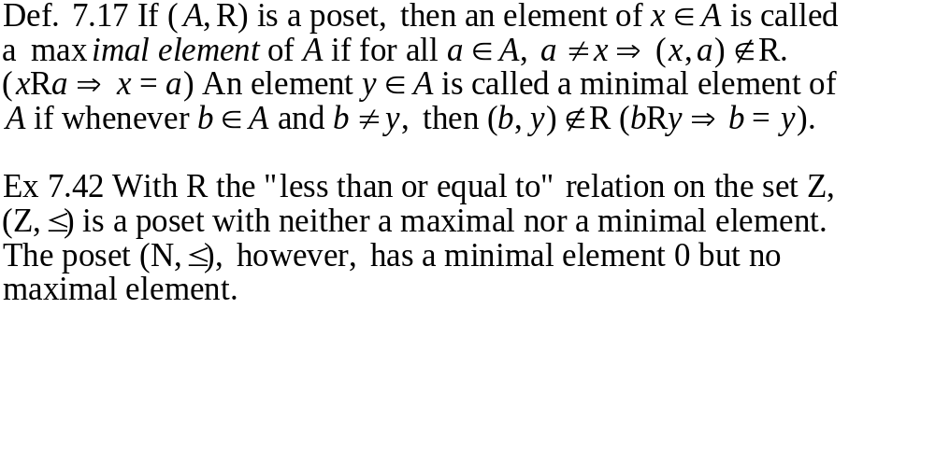
7.3 Partial Orders: Hasse Diagrams

Slide 30
7.3 Partial Orders: Hasse Diagrams
Ex.7.43
{1,2,3}max
max
8 max
385
{1,2} {1,3} {2,3}
12
4
max and min
35
6
{1} {2} {3}
2
3
5
7
2
2
3
5
7
11
1 min
min
min
unique max and min

Slide 31
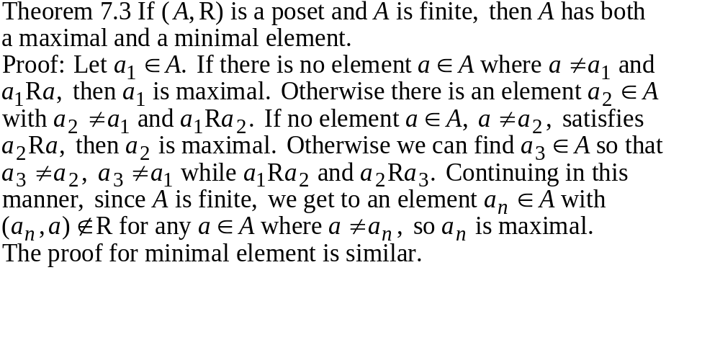
7.3 Partial Orders: Hasse Diagrams
In topological sorting, each time we find a maximal element,
or each time we find a minimal element.

Slide 32
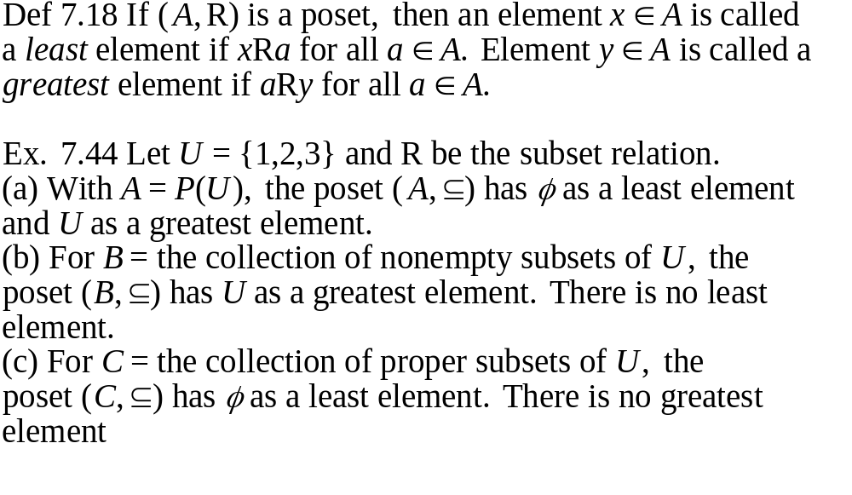
7.3 Partial Orders: Hasse Diagrams

Slide 33
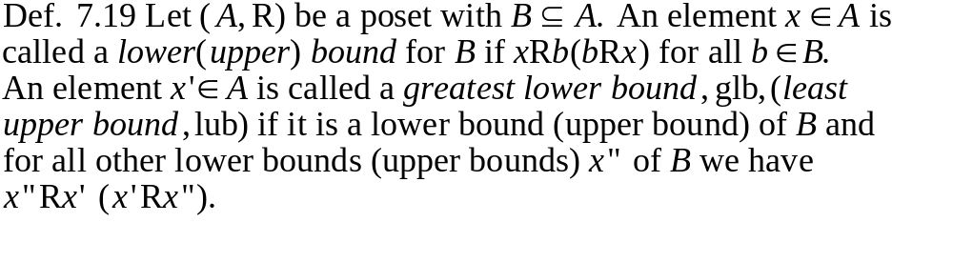
7.3 Partial Orders: Hasse Diagrams
Theorem 7.4 If the poset (A,R) has a greatest (least) element,
then that element is unique.
Proof: Suppose that x,y in A and that both are greatest elements.
Then (x,y) and (y,x) are both in R. As R is antisymmetric, it
follows that x=y. The proof for the least element is similar.

Slide 34

7.3 Partial Orders: Hasse Diagrams
Ex. 7.46 Let U={1,2,3,4}, with A=P(U), let R be the subset
relation on A. If B={{1},{2},{1,2}}, then {1,2}, {1,2,3},
{1,2,4}, and {1,2,3,4} are all upper bounds for B(in A),
whereas {1,2} is a least upper bound (in B). Meanwhile, a
greatest lower bound for B is the empty set, which is not in B.
Ex. 7.47 Let R be the "less than or equal to" relation for the poset
(A,R). (a) If A=R and B=[0,1] or [1,0) or (0,1] or (0,1), then B
has glb 0 and lub 1. (b) If A=R, B={q in Q|q²<2}. Then B has
as a lub and -
as glb, and neither of these is in B.
(c) A=Q, with B as in part (b). Here B has no lub or glb.

Slide 35
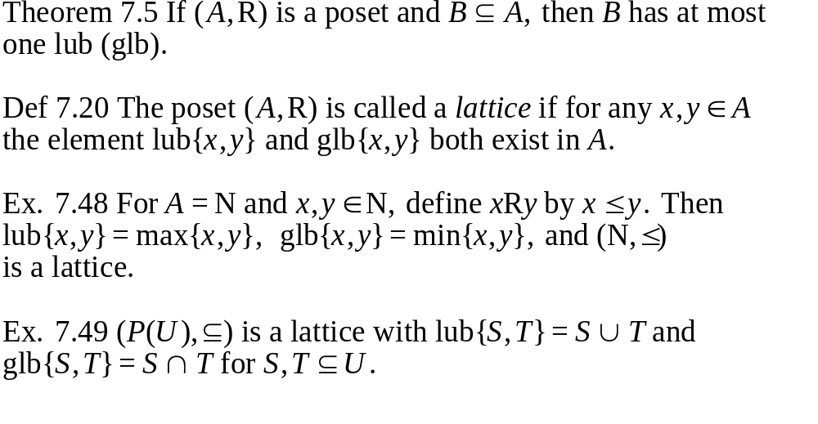
7.3 Partial Orders: Hasse Diagrams

Slide 36
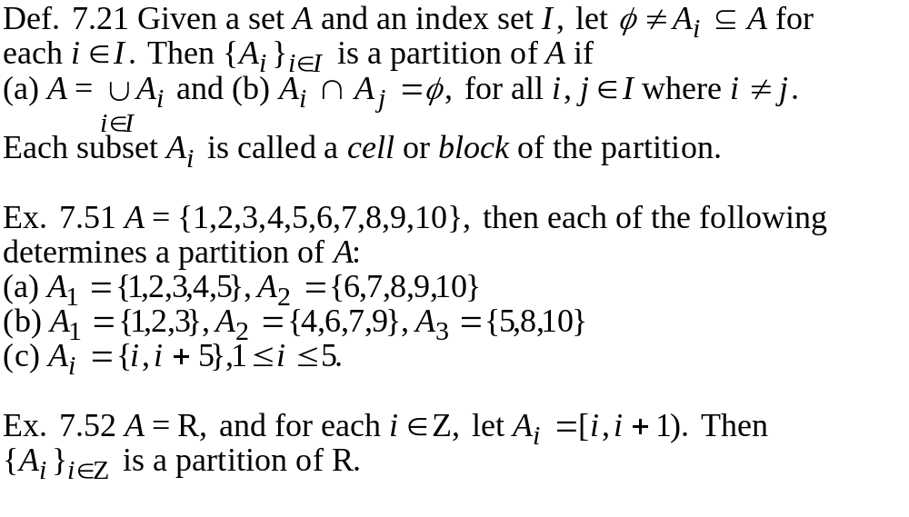
7.4 Equivalence Relations and Partitions

Slide 37
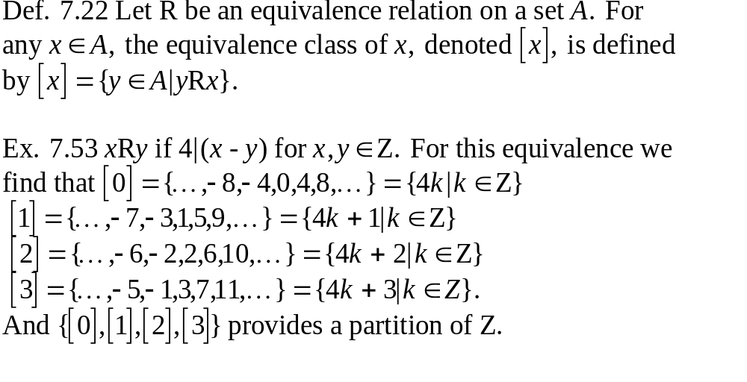
7.4 Equivalence Relations and Partitions

Slide 38
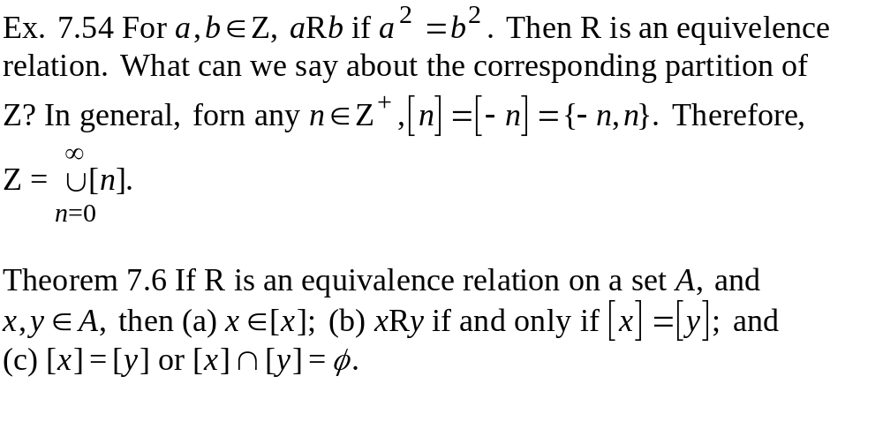
7.4 Equivalence Relations and Partitions

Slide 39
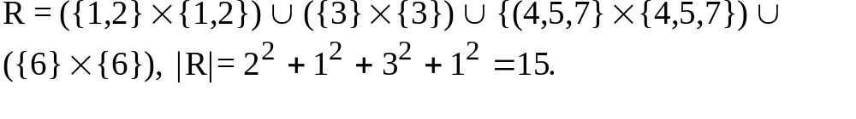
7.4 Equivalence Relations and Partitions
Ex. 7.58 If an equivalence relation R on A={1,2,3,4,5,6,7} induces
the partition ? What is R?
Theorem 7.7 If A is a set, then (a) any equivalence relation R on A
induces a partition of A, and (b) any partition of A gives rise to an
equivalence relation on A.
Theorem 7.8 For any set A, there is a one-to-one correspondence
between the set of equivalence relations on A and the set of
partitions of A.

Slide 40
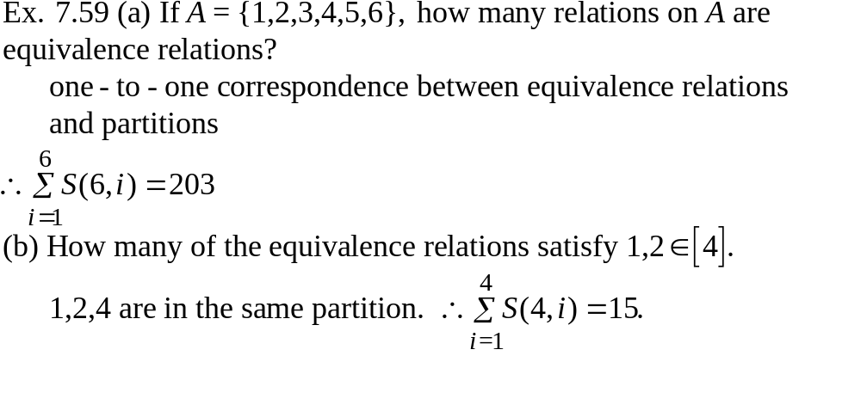
7.4 Equivalence Relations and Partitions

Slide 41
7.5 Finite State Machines: The Minimization Process
Given s₁,s₂ in S, the relation 1-equivalence, which is denoted
by s₁E₁s₂, is defined when w(s₁,x)=w(s₂,x) for all x in I. This
idea can be extended to states being k-equivalence, where
s₁E_{k}s₂ if w(s₁,y)=w(s₂,y) for all y in I^{k}.
If two states are k-equivalent for all k in Z⁺, then they are called
equivalent, denoted by s₁Es₂. Hence our objective is to determine
the partition of S induced by the equivalence relation E and select
one state for each equivalence class.

Slide 42
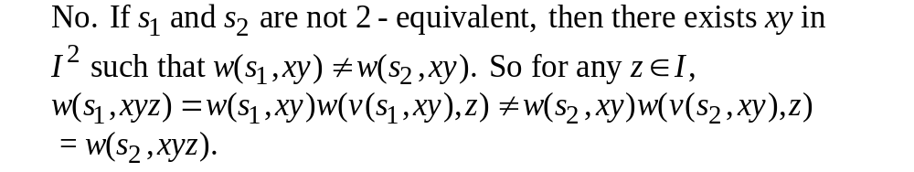
7.5 Finite State Machines: The Minimization Process
observations:
(1) If two states in a machine are not 2-equivalent, could they
possibly be 3-equivalent?
In general, to find states that are (k+1)-equivalent, we look at
states that are k-equivalent.

Slide 43
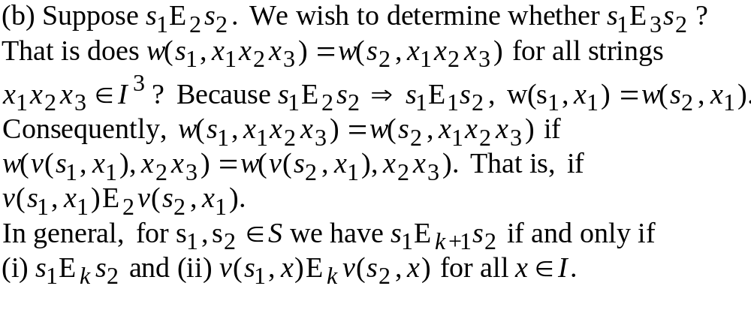
7.5 Finite State Machines: The Minimization Process
observations:

Slide 44
7.5 Finite State Machines: The Minimization Process
Ex. 7.60
step 1: determine 1-equivalent states by
examining outputs
v
w
0 1 0 1
s₁ s₄ s₃ 0 1
s₂ s₅ s₂ 1 0
s₃ s₂ s₄ 0 0
s₄ s₅ s₃ 0 0
s₅ s₂ s₅ 1 0
s₆ s₁ s₆ 1 0
P₁: {s₁},{s₂, s₅, s₆},{ s₃, s₄}
A
B
input 0
C
s₅ s₂ s₁ s₂ s₅
P₂: {s₁},{s₂, s₅},{ s₆},{ s₃, s₄}
D
input 1
s₂ s₅ s₄ s₃
P₃=P₂, the process is complete with 4 states.

Slide 45
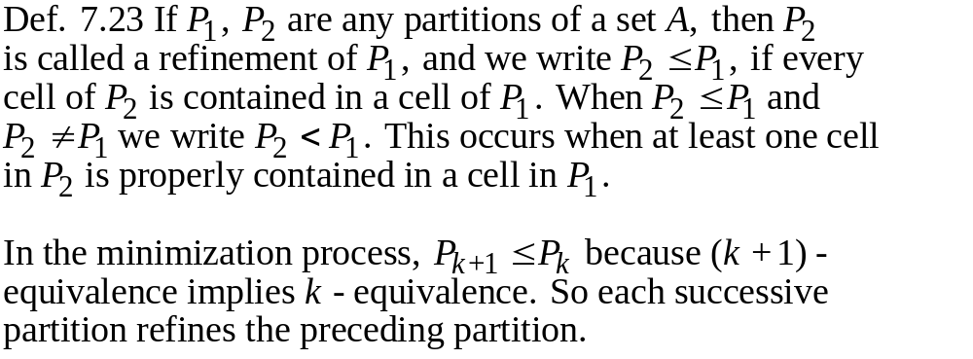
7.5 Finite State Machines: The Minimization Process
Could it be that P₃=P₂, but P₃=P₄?

Slide 46
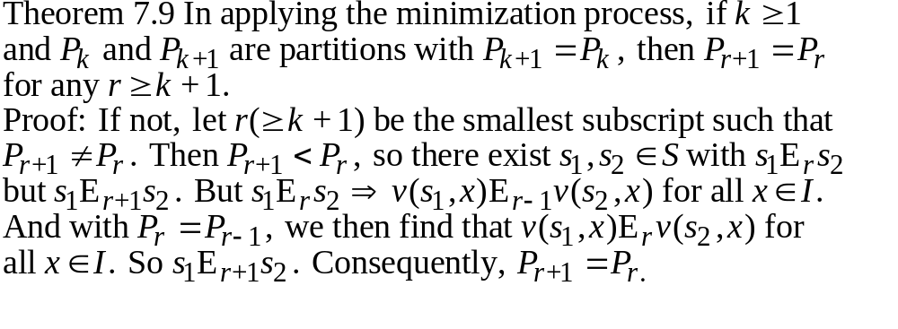
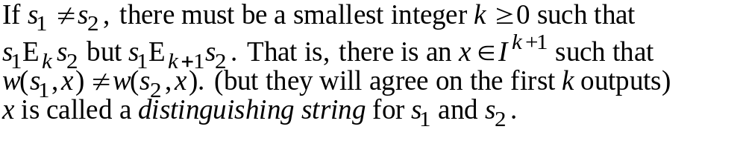
7.5 Finite State Machines: The Minimization Process

Slide 47
7.5 Finite State Machines: The Minimization Process
How to find the minimal length distinguishing string?
Ex. 7.61
v
w
P₁: {s₁},{s₂, s₅, s₆},{ s₃, s₄}
0 1 0 1
input 0
s₁ s₄ s₃ 0 1
s₂ s₅ s₂ 1 0
s₃ s₂ s₄ 0 0
s₄ s₅ s₃ 0 0
s₅ s₂ s₅ 1 0
s₆ s₁ s₆ 1 0
s₅ s₂ s₁ s₂ s₅
P₂: {s₁},{s₂, s₅},{ s₆},{ s₃, s₄}
input 1
s₂ s₅ s₄ s₃
A distinguishing string for s₂ and s₆ is 00 (or 01).

Slide 48
7.5 Finite State Machines: The Minimization Process
Ex. 7.62
v
w
P₁: {s₁ ,s₃, s₄},{s₂, s₅}
0 1 0 1
input 1
s₁ s₄ s₂ 0 1
s₂ s₅ s₂ 0 0
s₃ s₄ s₂ 0 1
s₄ s₃ s₅ 0 1
s₅ s₂ s₃ 0 0
s₂ s₂ s₅ s₂ s₃
P₂: {s₁ ,s₃, s₄},{s₂},{ s₅}
input 1
s₂ s₂ s₅
P₃: {s₁ ,s₃},{ s₄},{s₂},{ s₅}
distinguishing string for s₁ and s₄: 111

Slide 49
Exercise: P318:10
P330:20
P340:26
P346:10
P356:14

